Slide 1

Exploratory analysis of Big Data and Cloud EDABDC
Data Models

Slide 2
Data Models
We have data, but need to be organized and managed!
Data models are frameworks for organizing and defining data elements and their relationships.
They provide a systematic way to manage data, which is essential for developing databases and information systems.

Slide 3
Importance of Data Models
Data Organization: Helps in organizing and structuring data efficiently.
Data Integrity: Ensures the accuracy and consistency of data through constraints and rules.
Data Access: Facilitates easy and efficient access to data for queries and transactions.
Scalability: Allows databases to scale and handle large volumes of data.
Maintenance: Simplifies data management and maintenance over time.

Slide 4
Why analyze data?
Enables informed decision-making
Identifies trends and patterns
Improves efficiency and reduces costs
Enhances understanding of customer / user behavior
Aids in risk management
Measures performance against KPIs
Helps make sense of complex information for better outcomes

Slide 5
Common data models
Hierarchical Data Model
Relational Data Model - Entity-Relationship Model (ER Model)
Document Data Model
Key-Value Data Mode
Graph Data Model
Multi-Model Databases

Slide 6
Common data models
Data Model | Structure | Relationships | Use Cases | Tools
Hierarchical Data Model | Tree-like structure | Parent-child | Organizational charts, file systems | XML
Relational Data Model Entity-Relationship Model | Tables (relations) Entities and relationships | Foreign keys and primary keys One-to-one, one-to-many, many-to-many | Financial systems, inventory management Database design | SQLite Browser, MS SQL Server, MySQL, PostgreSQL, BigER vs code plugin
Document Data Model (NoSQL database) | Documents (JSON, XML) | Embedded relationships | Content management systems, web applications | MongoDB, CouchDB
Key-Value Data Model | Key-value pairs | Simple lookup | Session storage, user profiles | Redis, DynamoDB

Slide 7
Common data models (Cont.)
Data Model | Structure | Relationships | Use Cases | Tools
Graph Data Model | Nodes and edges | Explicitly stored edges | Social networks, recommendation engines | Neo4j, OrientDB
Multi-Model Databases | Supports multiple data models | Various types | Flexible data handling, diverse use cases | ArangoDB, Couchbase

Slide 8
Common data models
Hierarchical Data Model
Relational Data Model - Entity-Relationship Model (ER Model)
Document Data Model
Key-Value Data Mode
Graph Data Model
Multi-Model Databases

Slide 9
Hierarchical Data Model
The Hierarchical Data Model is one of the oldest database models, developed in the 1960s.
It organizes data in a tree-like structure where each record has a single parent and potentially many children, resembling a hierarchy.

Slide 10
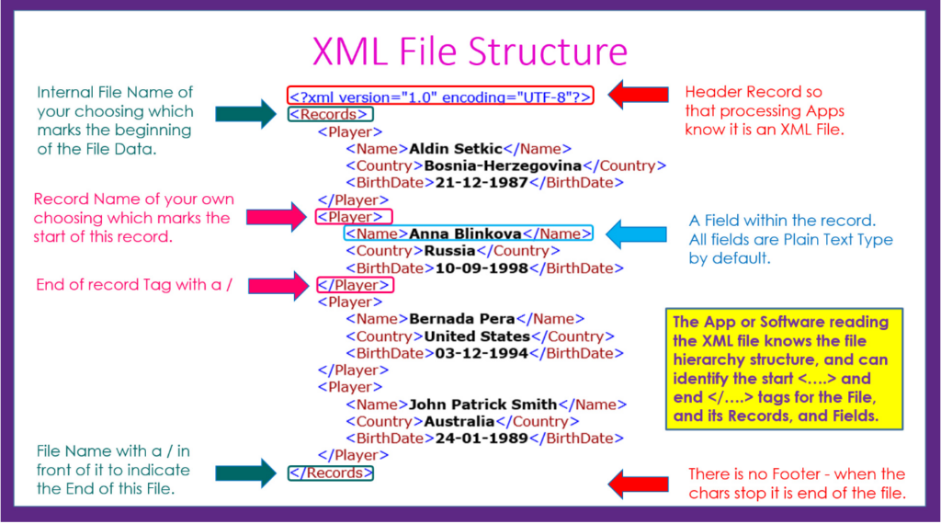

Slide 11
XML applications
Data Interchange: Facilitates data exchange between different systems.
Configuration Files: Stores application settings in a structured format.
Data Representation: Represents complex data in a human-readable format.
RSS and Atom Feeds: Powers syndication formats for web content distribution.
Office Document Formats: Forms the basis of modern office file formats (e.g., DOCX).

Slide 12
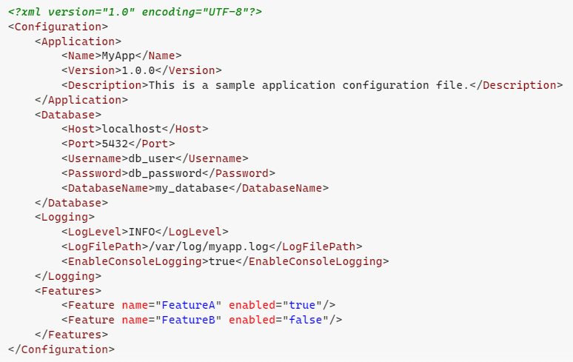
Example XML Configuration File

Slide 13
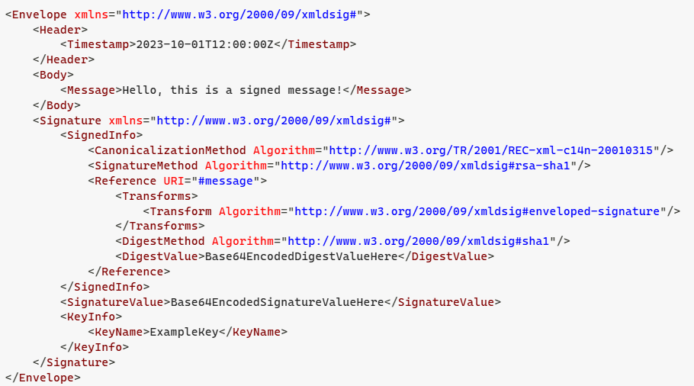
Digital signature

Slide 14
Digital signature
XML is used in digital signatures, particularly through a standard known as XML Signature (or XMLDSig). This standard allows for the signing of XML data to ensure its integrity, authenticity, and non-repudiation. Here are some key aspects of XML digital signatures:
Integrity: XML signatures ensure that the signed data has not been altered after signing.
Authentication: They verify the identity of the signer, confirming that the signature was created by a legitimate source.
Non-repudiation: The signer cannot deny having signed the document, as the signature is uniquely tied to the signer.
Interoperability: XML signatures can be used across different platforms and applications, making them suitable for various digital transactions.
Support for Multiple Formats: XML Signature can be applied to any XML data, allowing for flexible use in different contexts.

Slide 15
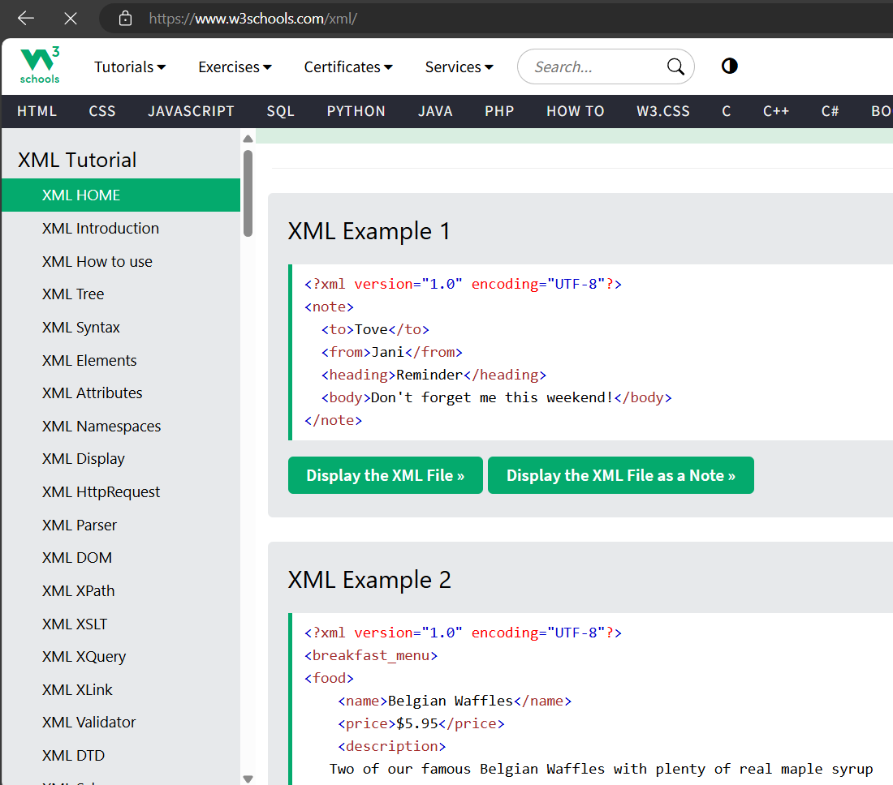
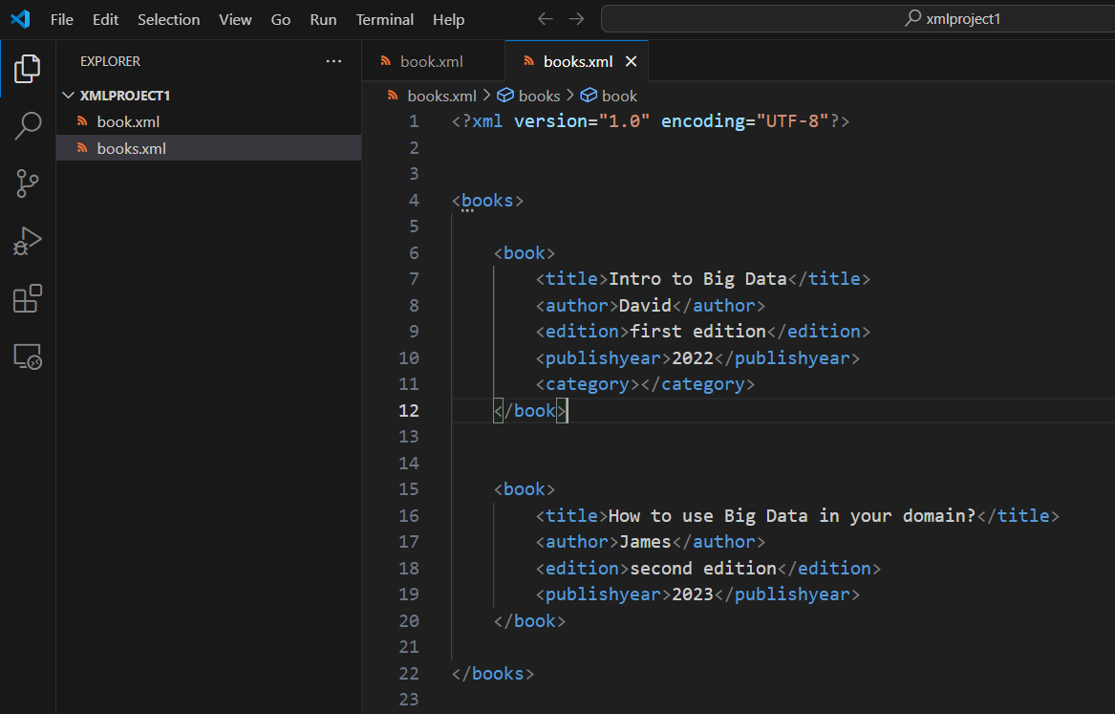
XML Tools
W3School https://www.w3schools.com/xml/
vscode with redhat xml plugin

Slide 16
XML attributes
Adding the gender attribute
<person>
<firstname>Anna</firstname>
<lastname>Smith</lastname>
</person>
<person gender="female">
<firstname>Anna</firstname>
<lastname>Smith</lastname>
</person>

Slide 17
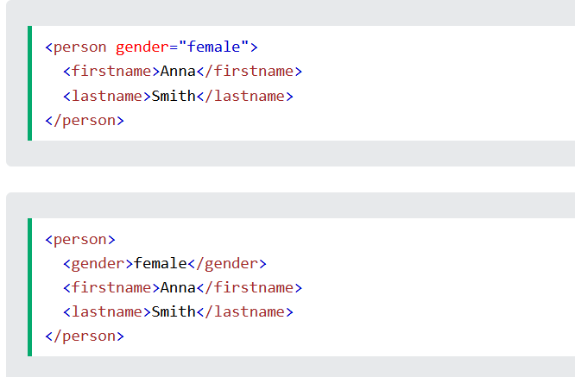
XML Elements vs. Attributes
Both examples provide the same information.

Slide 18

Questions

Slide 19
Common data models
Hierarchical Data Model
Relational Data Model - Entity-Relationship Model (ER Model)
Document Data Model
Key-Value Data Model
Graph Data Model
Multi-Model Databases

Slide 20
Relational Data Model
The Relational Data Model is one of the most widely used data models in database management systems.
Introduced in 1970 and has become the foundation for modern relational database management systems (RDBMS).

Slide 21
Relational Data Model Key Characteristics
Tables (Relations): Data is organized into tables, which consist of rows and columns. Each table represents a relation, and each row in the table represents a record.
Rows (Tuples): Each row in a table is called a tuple, representing a single record with a unique set of values.
Columns (Attributes): Each column in a table represents an attribute or field. Columns define the properties of the data.
Primary Keys: Each table has a primary key, a unique identifier for each row. The primary key ensures that each record can be uniquely identified.
Foreign Keys: Foreign keys are used to establish relationships between tables. A foreign key in one table refers to the primary key of another table, enabling the creation of relational links.
Normalization: The process of organizing data to minimize redundancy and improve data integrity. Normalization involves decomposing tables into smaller, related tables.

Slide 22
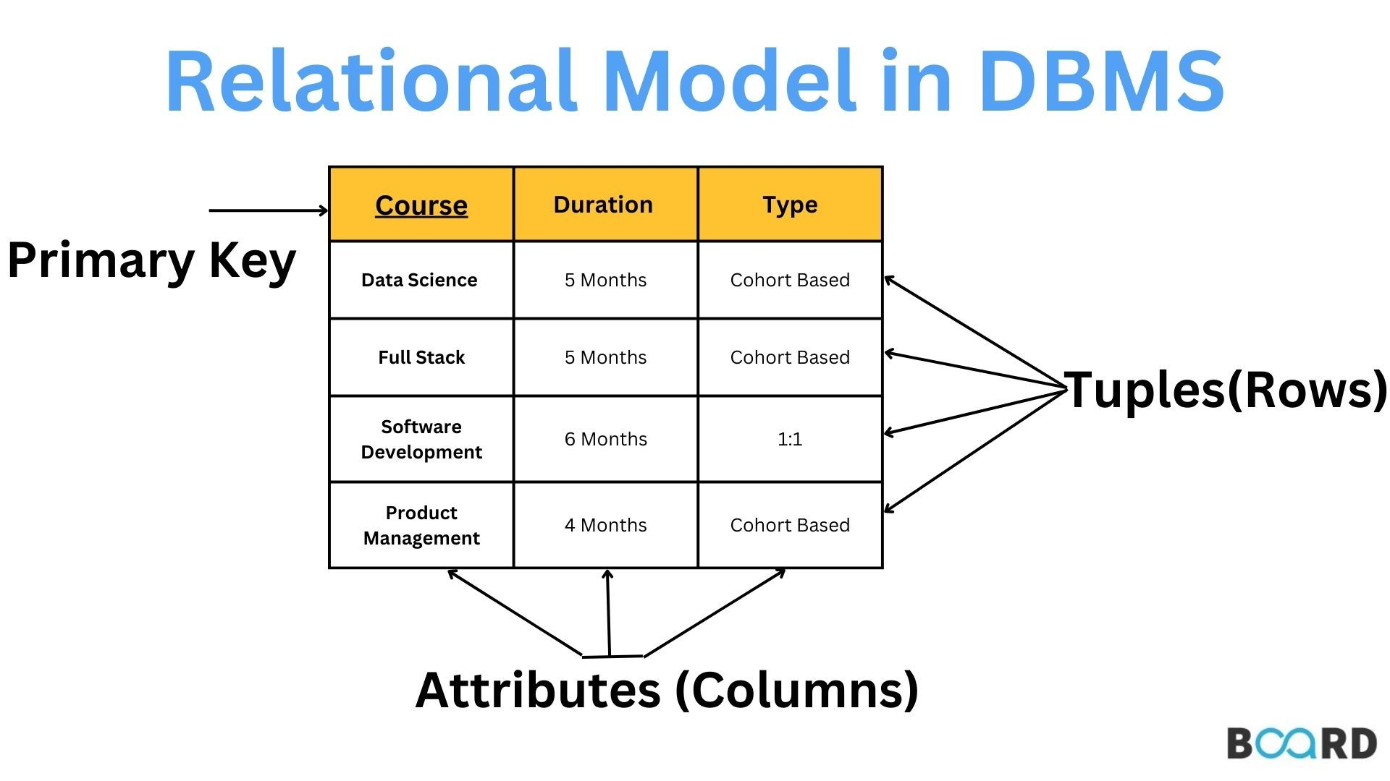

Slide 23
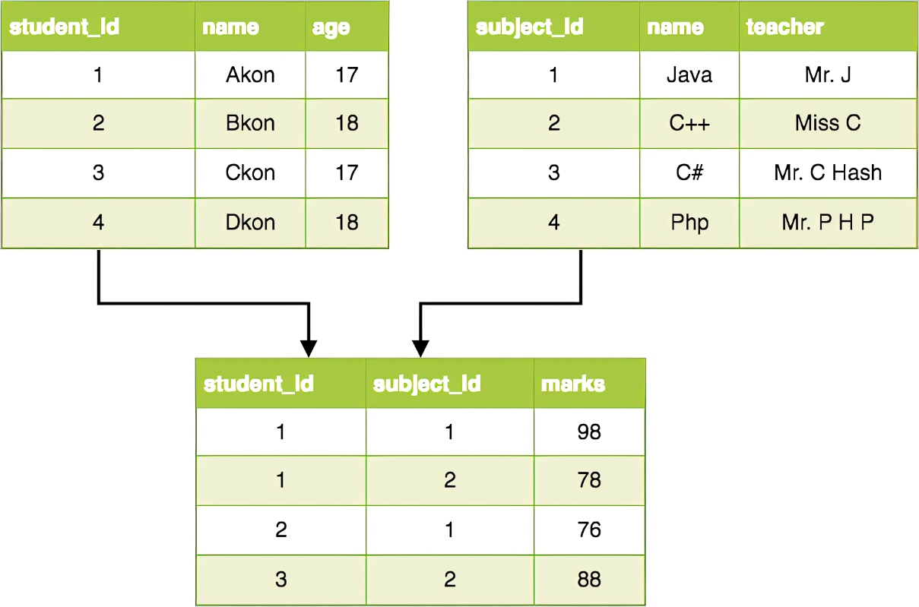
Relation in RDM
Subject
Student
Enrollments

Slide 24
Relation Data Model Use Cases
Business Applications: Enterprise resource planning (ERP), customer relationship management (CRM), and other business applications.
Financial Systems: Banking, insurance, and other financial services.
E-commerce: Online retail platforms, inventory management systems.
Healthcare: Patient records, hospital management systems.
....

Slide 25
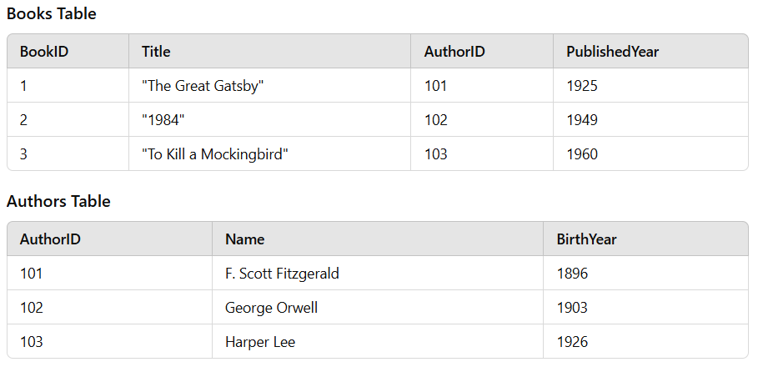
Example

Slide 26
if we do not make relations, we have redundant data
book_id | title | genre | author_name | biography
1 | Harry Potter | Fantasy | J.K. Rowling | British author known for creating the magical world of Harry Potter.
2 | 1984 | Dystopian | George Orwell | English novelist famous for his dystopian novels exploring political and social themes.
3 | The Hobbit | Fantasy | J.R.R. Tolkien | English writer, poet, and professor best known for his high-fantasy works.
4 | Pride and Prejudice | Romance | Jane Austen | English novelist renowned for her keen observations on societal manners and relationships.
5 | To Kill a Mockingbird | Fiction | Harper Lee | American novelist celebrated for her profound storytelling and themes of racial injustice.
6 | Animal Farm | Political satire | George Orwell | English novelist famous for his dystopian novels exploring political and social themes.
7 | Sense and Sensibility | Romance | Jane Austen | English novelist renowned for her keen observations on societal manners and relationships.

Slide 27
SQL Queries
Selecting Data: Retrieve all books published after 1930.
SELECT * FROM Books WHERE PublishedYear > 1930;
Joining Tables: Retrieve a list of books along with their authors.
SELECT Books.Title, Authors.Name
FROM Books
JOIN Authors ON Books.AuthorID = Authors.AuthorID;

Slide 28
Learn SQL
https://www.w3schools.com/sql/

Slide 29
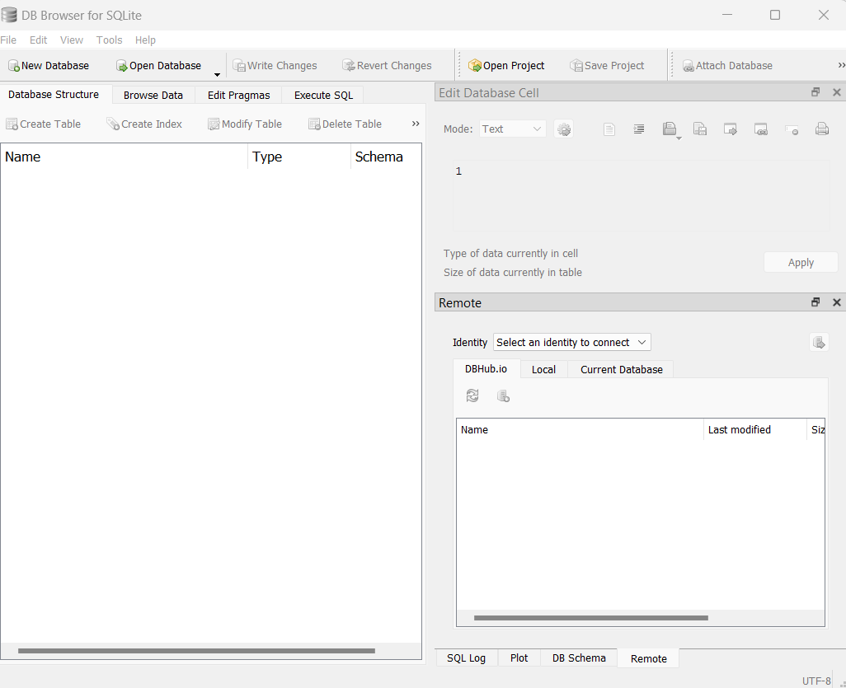
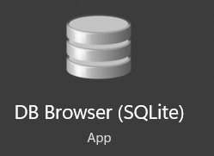
Tools
SQLite Browser

Slide 30
Relations in Relational data model (RDM)
In a relational data model, relationships between entities (tables) are crucial for organizing and structuring the data effectively.
These relationships help in defining how data in one table is related to data in another table.

Slide 31
Keys in Relationships
Primary Key (PK): A unique identifier for a record in a table.
Foreign Key (FK): A field in one table that uniquely identifies a row of another table. It is used to establish and enforce a link between the data in the two tables.

Slide 32
One-to-Many (1:N) Relationship
In a one-to-many relationship, a record in one table (the "one" side) can be related to multiple records in another table (the "many" side), but each record in the "many" side is related to only one record in the "one" side. This is the most common type of relationship.

Slide 33
1:N relationship example: two tables, Department and Employee.
Department table: Contains information about departments.
Employee table: Contains information about employees.
Each department can have multiple employees, but each employee belongs to only one department.
Department Employee
----------- -----------
DepartmentID (PK) EmployeeID (PK)
DepartmentName Name
DateOfBirth
DepartmentID (FK)

Slide 34
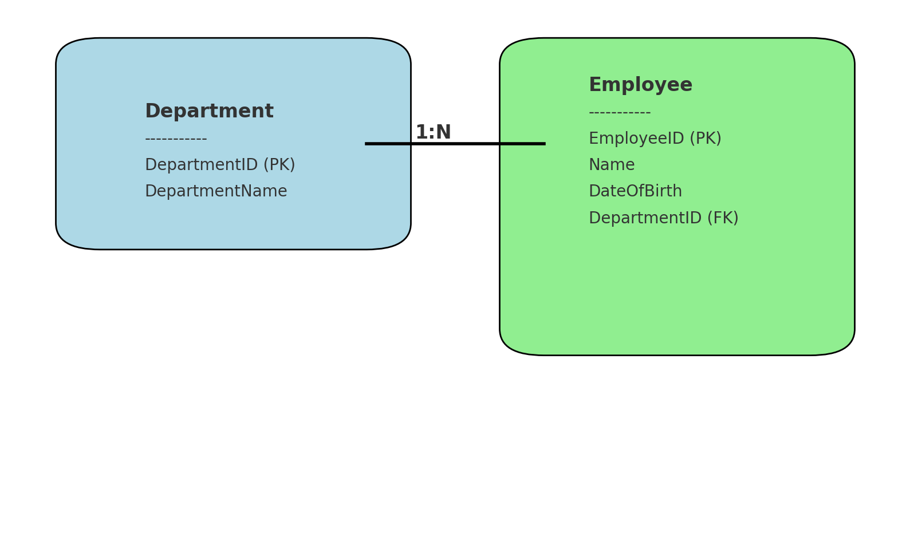
Dept - Emptloyees relation

Slide 35
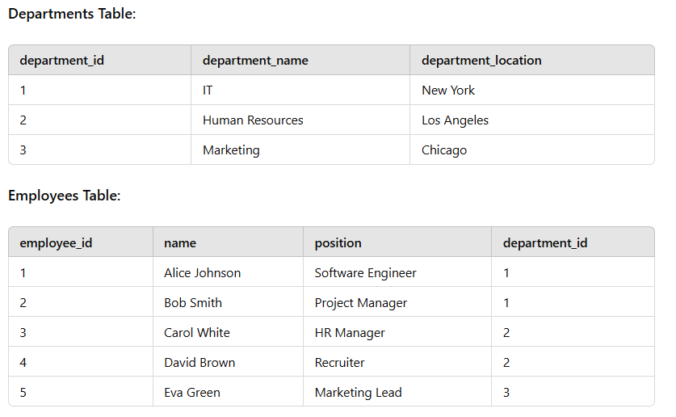

Slide 36
Many-to-Many (M:M) Relationship
In a many-to-many relationship, records in one table can be related to multiple records in another table, and vice versa.
This type of relationship is usually implemented using a junction table (also called a bridge table or associative entity) that contains foreign keys referencing the primary keys of the two related tables.

Slide 37
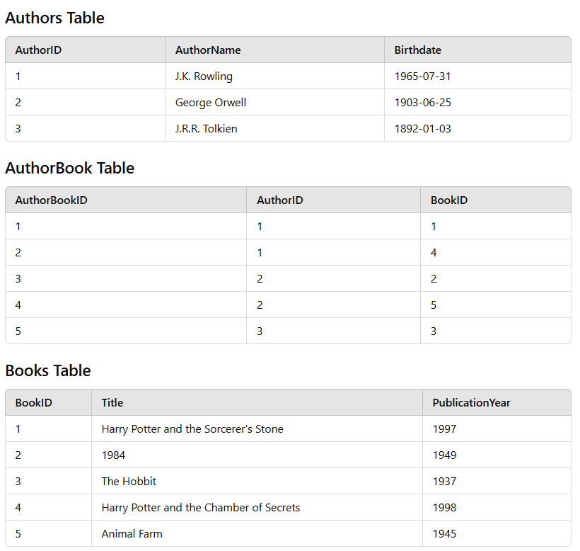
M:M example

Slide 38
RDBMS data model examples
https://datamodels.databases.biz/

Slide 39
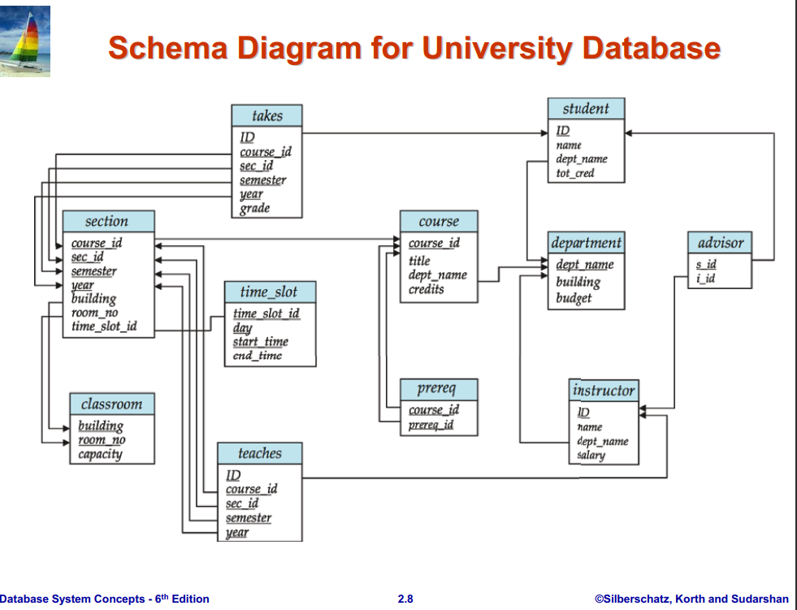

Slide 40
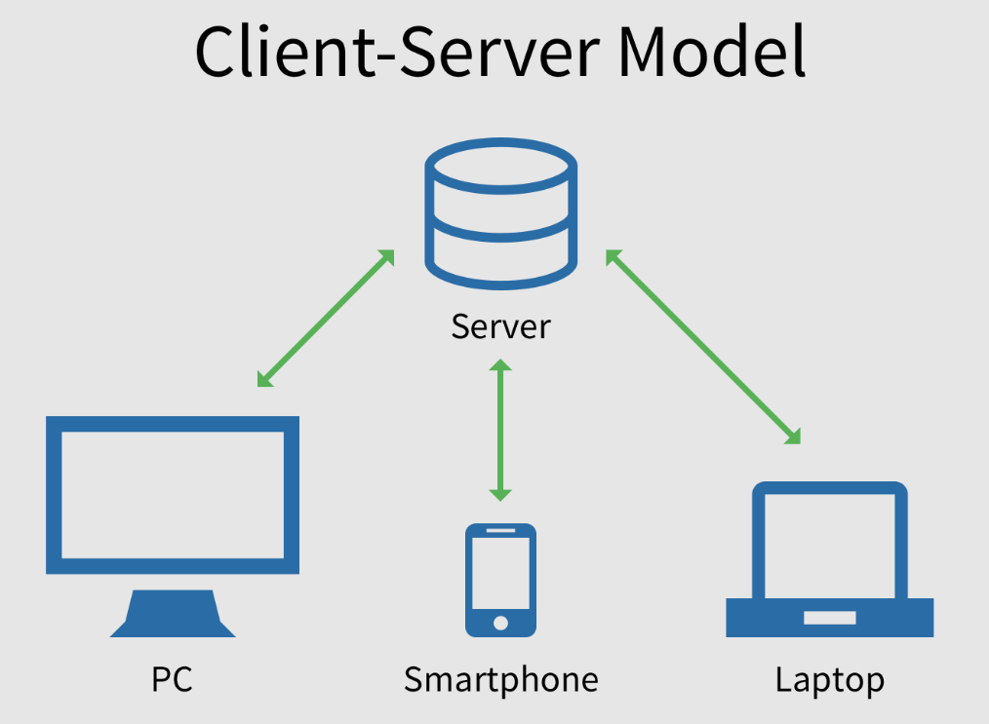
Client server model - on premise

Slide 41



Client server model - database on the cloud

Slide 42
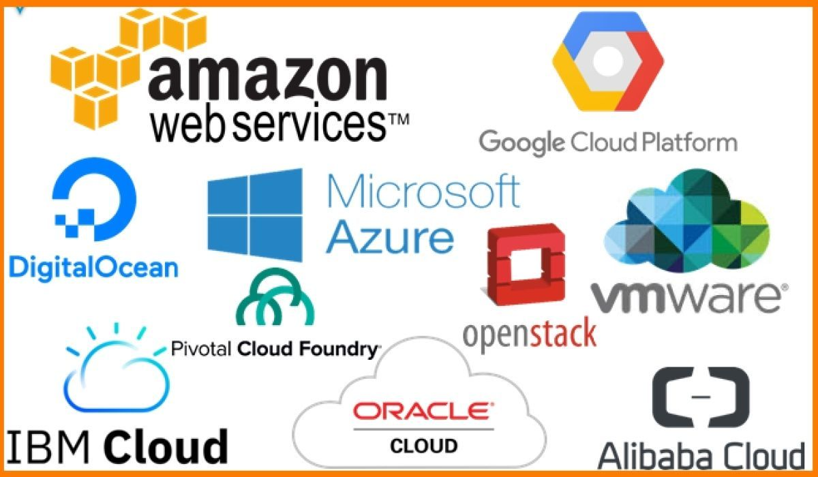
Cloud Providers

Slide 43
Questions

Slide 44
Common data models
Hierarchical Data Model
Relational Data Model - Entity-Relationship Model (ER Model)
Document Data Model
Key-Value Data Mode
Graph Data Model
Multi-Model Databases

Slide 45
The Document Data Model
The Document Data Model is a type of NoSQL database model that is designed for storing, retrieving, and managing semi-structured or structured data as documents.

Slide 46
Key aspects of the Document Data Model
Structure:
Documents are self-contained pieces of data that store information in a standard format, typically JSON (JavaScript Object Notation), BSON (Binary JSON), XML, or similar formats.
Each document is stored in the database as a unique record and does not require a fixed schema like traditional relational databases.
Tool:
MongoDB: A popular document database that uses BSON (Binary JSON) for storage. It is widely used for its scalability, flexibility, and ease of use.

Slide 47
Key aspects of the Document Data Model (Cont.)
Use Cases:
Content Management Systems: Flexible schemas are perfect for storing varied content types like articles, images, and videos.
E-Commerce: Store product catalogs where each product has unique attributes (e.g., clothing might have size and color, while electronics might have battery life).
User Profiles: Store user data with varying details (e.g., one user has a phone number, another has multiple addresses).
IoT and Event Logging: Store semi-structured or hierarchical sensor data and logs.

Slide 48
JSON documents
JSON is a format for storing and transporting data.
JSON stands for JavaScript Object Notation
JSON is a lightweight data interchange format
JSON is language independent
JSON is "self-describing" and easy to understand

Slide 49
JSON Example
{
"employees":[
{"firstName":"John", "lastName":"Doe"},
{"firstName":"Anna", "lastName":"Smith"},
{"firstName":"Peter", "lastName":"Jones"}
]
}

Slide 50
JSON Syntax Rules
Data is in name/value pairs
Data is separated by commas
Curly braces hold objects
Square brackets hold arrays

Slide 51
JSON Data - A name and a Value
A name/value pair consists of a field name (in double quotes), followed by a colon, followed by a value:
"firstName":"John"

Slide 52
JSON Objects
JSON objects are written inside curly braces.
{"firstName":"John", "lastName":"Doe"}

Slide 53
JSON Arrays
JSON arrays are written inside square brackets.
"employees":[
{"firstName":"John", "lastName":"Doe"},
{"firstName":"Anna", "lastName":"Smith"},
{"firstName":"Peter", "lastName":"Jones"}
]

Slide 54
JSON Complete Example again
{
"employees":[
{"firstName":"John", "lastName":"Doe"},
{"firstName":"Anna", "lastName":"Smith"},
{"firstName":"Peter", "lastName":"Jones"}
]
}

Slide 55
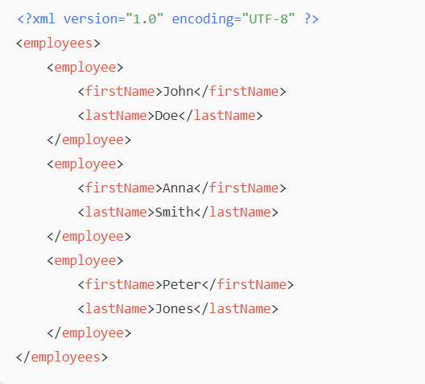
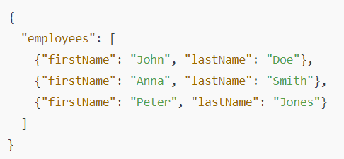
JSON vs XML

Slide 56
MongoDB
MongoDB is a document database. It stores data in a type of JSON format.
A record in MongoDB is a document, which is a data structure composed of key value pairs similar to the structure of JSON objects.
Records in a MongoDB database are called documents, and the field values may include numbers, strings, booleans, arrays, or even nested documents.
Can be installed locally or hosted in the cloud.

Slide 57
Example Document
{
"postId": "12345",
"title": "Understanding JSON in Document Databases",
"author": "Jane Doe",
"content": "JSON is a lightweight data-interchange format that is easy for humans to read and write and easy for machines to parse and generate.",
"tags": ["JSON", "databases", "NoSQL"],
"publishedDate": "2025-01-25",
"comments": [
{
"author": "John Smith",
"content": "Great explanation of JSON and its role in NoSQL databases!"
} ]
}

Slide 58
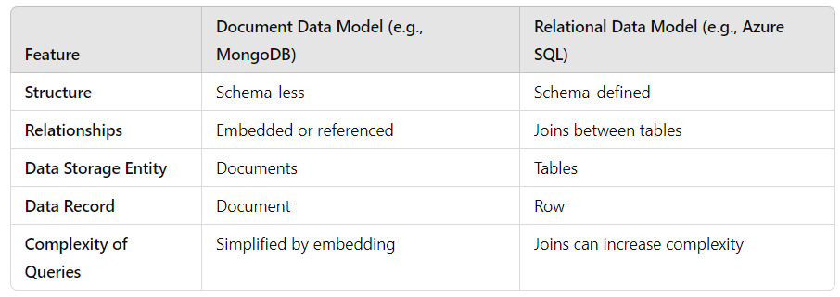
SQL vs Document Databases

Slide 59
Challenges of the Document Data Model
Redundancy:
Embedded data can lead to duplication, which may increase storage requirements.
Consistency:
Ensuring consistency in applications with embedded data requires careful design.
Complex Relationships:
While embedding simplifies simple relationships, complex many-to-many relationships may be less efficient than relational databases.
Indexing and Querying:
Indexing deeply nested fields can add overhead, and querying large documents can affect performance.

Slide 60
Local vs Cloud Database
MongoDB can be installed locally, which will allow you to host your own MongoDB server on your hardware. This requires you to manage your server, upgrades, and any other maintenance.
You can download and use the MongoDB open source Community Server on your hardware for free.
on the other hand, you can use MongoDB Atlas, a cloud database platform. This is much easier than hosting your own local database.
To be able to experiment with the code examples, you will need access to a MongoDB database.

Slide 61
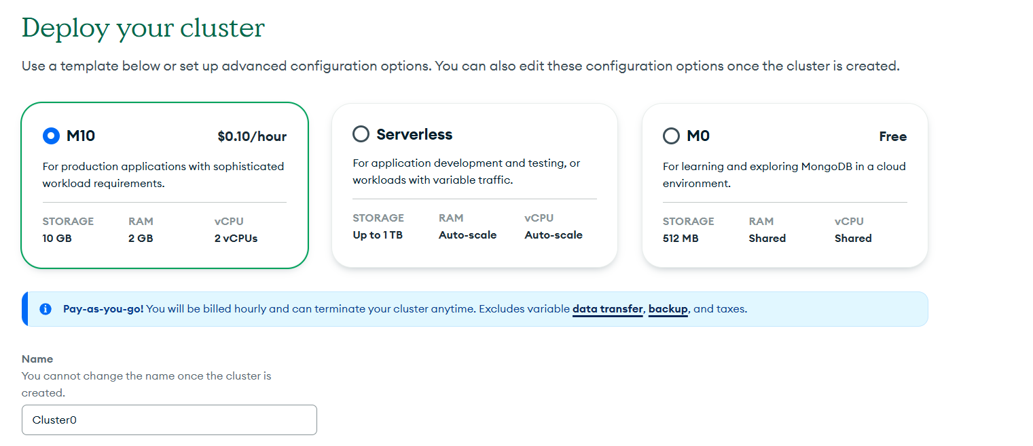
MongoDB Atlas

Slide 62
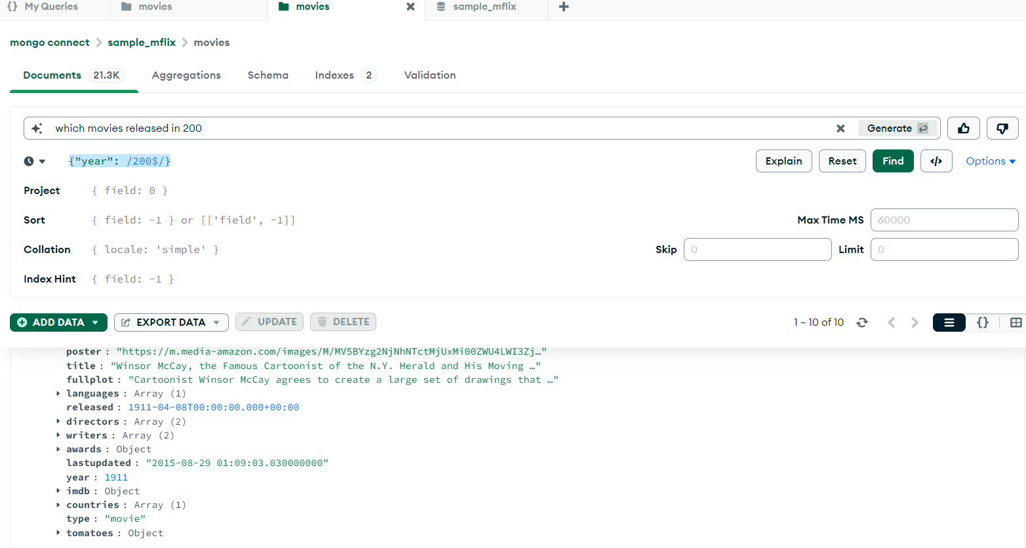
Generate Queries in natural language

Slide 63
Mongodb Compass docs
https://www.mongodb.com/docs/compass/current/

Slide 64
Creating Indexes
to improve the performance of query time

Slide 65
Blogs doc sample
[
{
"title": "Exploring the Future of AI Technology",
"date": "2024-06-01",
"body": "Artificial Intelligence (AI) is rapidly evolving and transforming various industries...",
"category": "news",
"tags": ["AI", "technology", "innovation"],
"like_count": 120,
"share_count": 45
},
.....
]

Slide 66
XML vs Table vs document data models
First Name | Last Name
John | Doe
Anna | Smith
Peter | Jones

Slide 67
Questions

